Slide 1
MGS 425 (S1S & S2S) Management of it projects
Week 11 – April 12th

Slide 2
Agenda
Chapter 19 – Sprint Planning
TopHat Assignment due by 11:59 pm on Sunday, April 18th

Slide 3
Sprint planning
Chapter 19

Slide 4
Sprint Planning
Chapter Outline
Overview
Timing
Participants
Process
Approaches to Sprint Planning
Two-Part Sprint Planning
One-Part Sprint Planning
Determining Capacity
What Is Capacity?
Capacity in Story Points
Capacity in Effort-Hours

Slide 5
Sprint Planning
Chapter Outline
Selecting Product Backlog Items
Acquiring Confidence
Refine the Sprint Goal
Finalize the Commitment
Closing

Slide 6
Sprint Planning - Overview
A product backlog may represent many weeks or months of work, which is much more than can be completed in a single, short sprint.
To determine the most important subset of product backlog items to build in the next sprint, the Scrum team performs sprint planning.
During sprint planning the Scrum team agrees on a goal for the sprint, and the development team determines the specific product backlog items that are aligned with that goal and that it can realistically deliver by the end of the sprint.
To acquire confidence in what it can deliver, the development team creates a plan for how to complete the product backlog items.
Together the product backlog items and the plan form the sprint backlog.

Slide 7
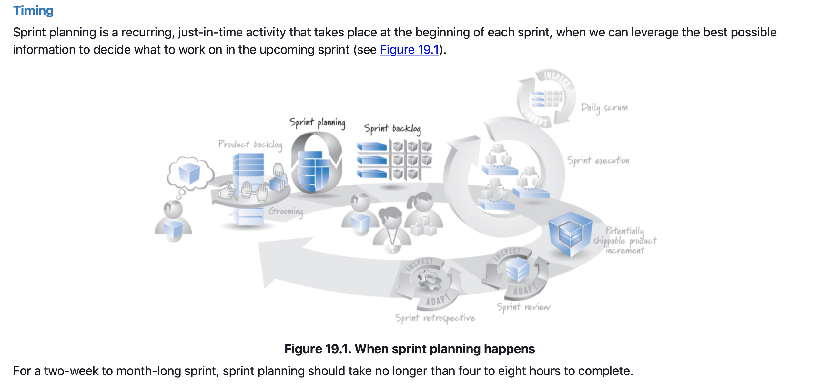
Sprint Planning – Overview (Timing)

Slide 8
Sprint Planning - Overview
Participants
The full Scrum team collaborates during sprint planning. Following is an outline of what each role on the team is expected to fulfill.
The product owner:
Shares the initial sprint goal.
Presents the prioritized product backlog.
Answers any questions the team might have regarding the product backlog items.
The development team :
Determined what it can deliver and then makes a realistic commitment at the end of sprint planning.
The ScrumMaster:
Observes the planning activity, asks probing questions, and facilitates to help ensure a successful result.
Notes:
Because the ScrumMaster is not in charge of the development team, she cannot decide on behalf of the development team what commitment to make. The ScrumMaster can, however, challenge the team’s commitment to ensure that it is realistic and appropriate.

Slide 9
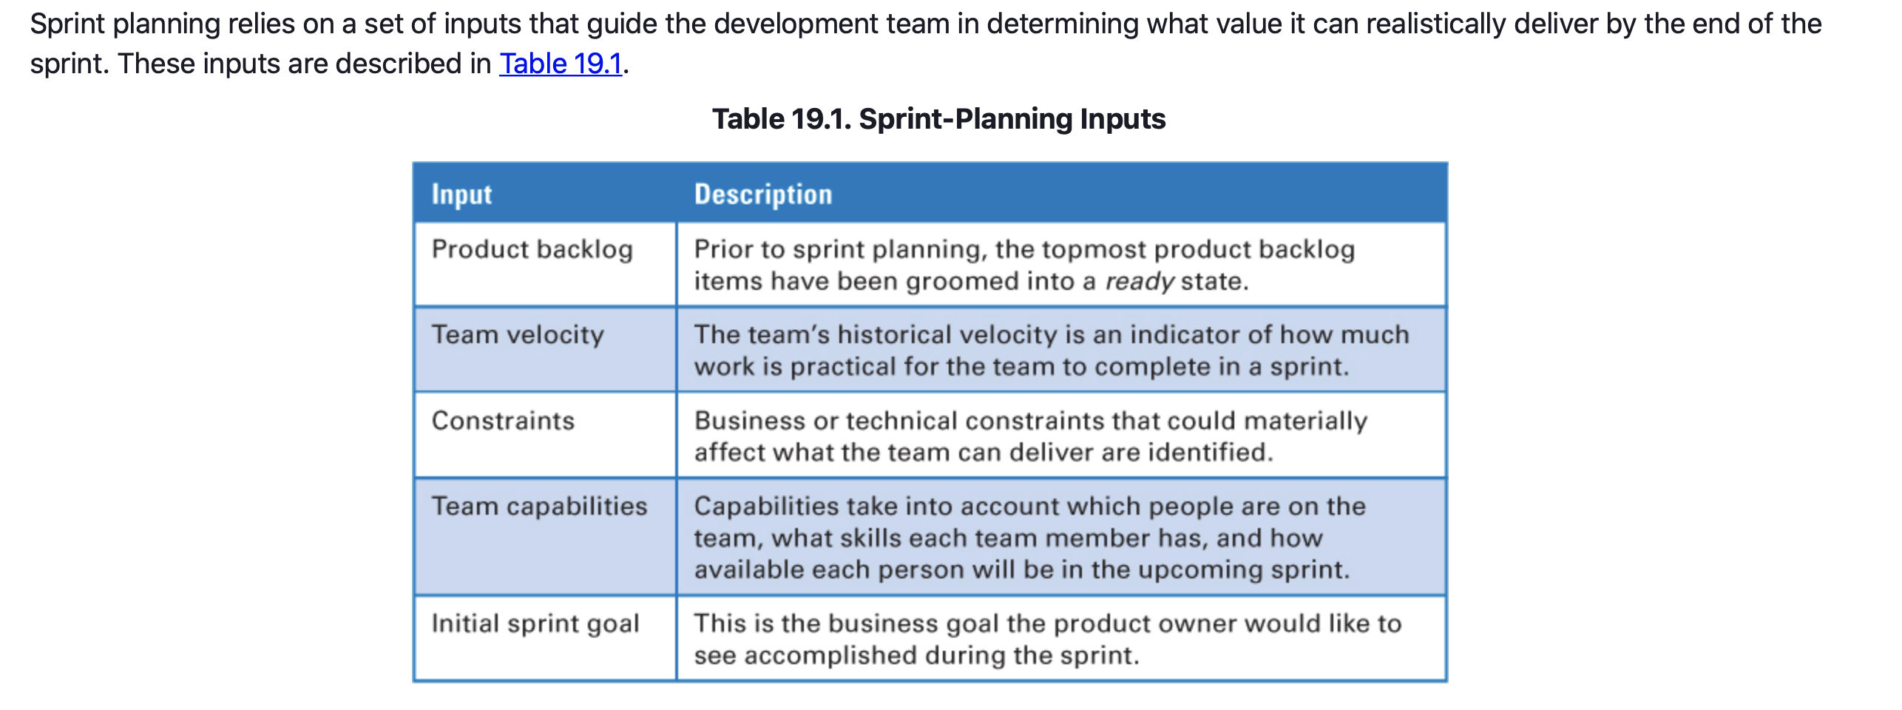
Sprint Planning – Process

Slide 10
Sprint Planning - Overview
Process
Engaged product owners enter sprint planning having a good idea of what they want the team to deliver by the end of the sprint.
They might have a specific set of high-priority product backlog items in mind—“I’d really like to get the top five product backlog items done this sprint”—or they might have a more general notion—“At the end of this sprint I want a typical user to be able to submit a simple keyword query.”
Knowing the sprint goal helps the team balance competing priorities.
A product owner should communicate the initial sprint goal in a way that doesn’t unduly influence the development team to commit to more than it realistically can deliver.

Slide 11
Sprint Planning - Overview
Process
The fact that the product owner knows what they want, however, does not necessarily mean that the development team is capable of delivering it during that sprint.
A realistic commitment is achieved only through collaboration (and at times negotiation) between the product owner and the development team members.
The sprint-planning participants need to have the opportunity to review and discuss potential value-generating alternatives and decide what is practical given the team’s capabilities, predicted velocity, and any known constraints.

Slide 12
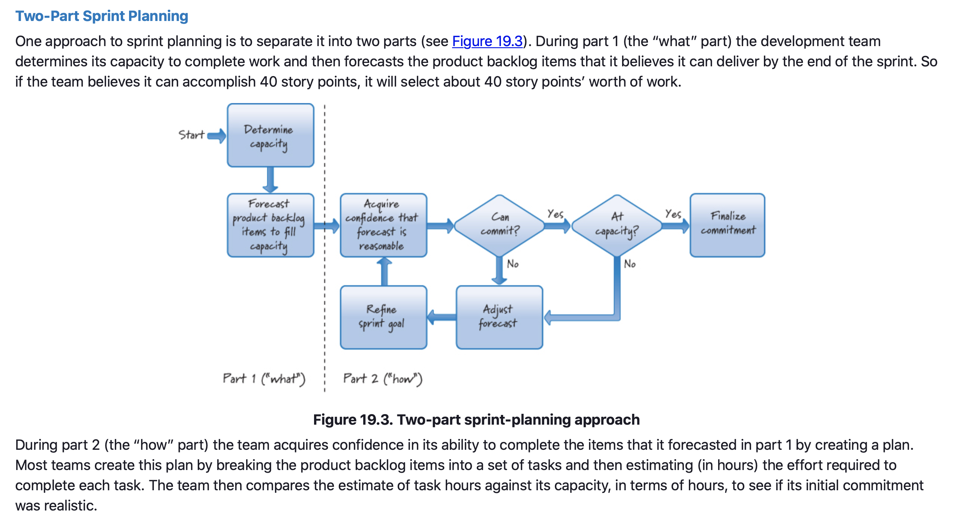
Sprint Planning - Approaches

Slide 13
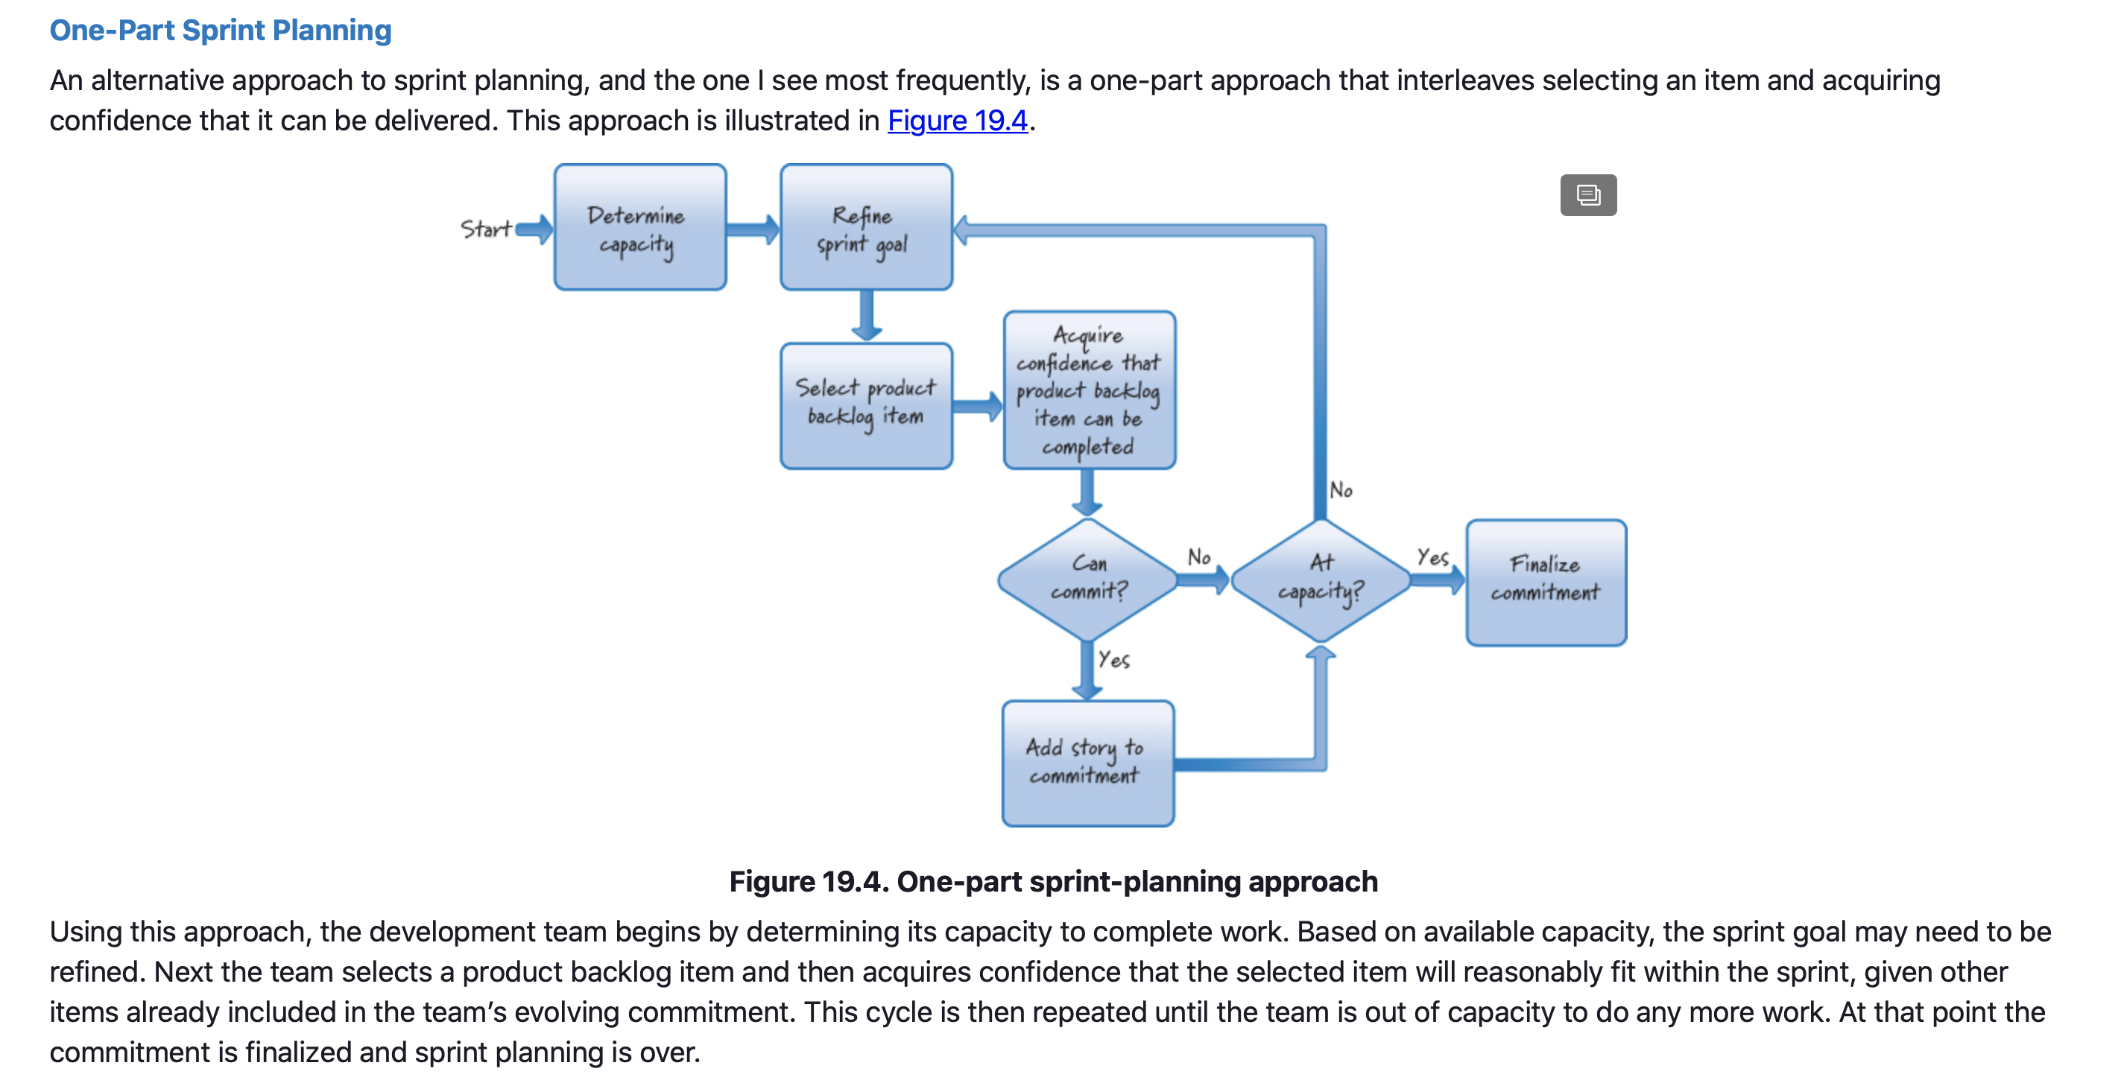
Sprint Planning - Approaches

Slide 14
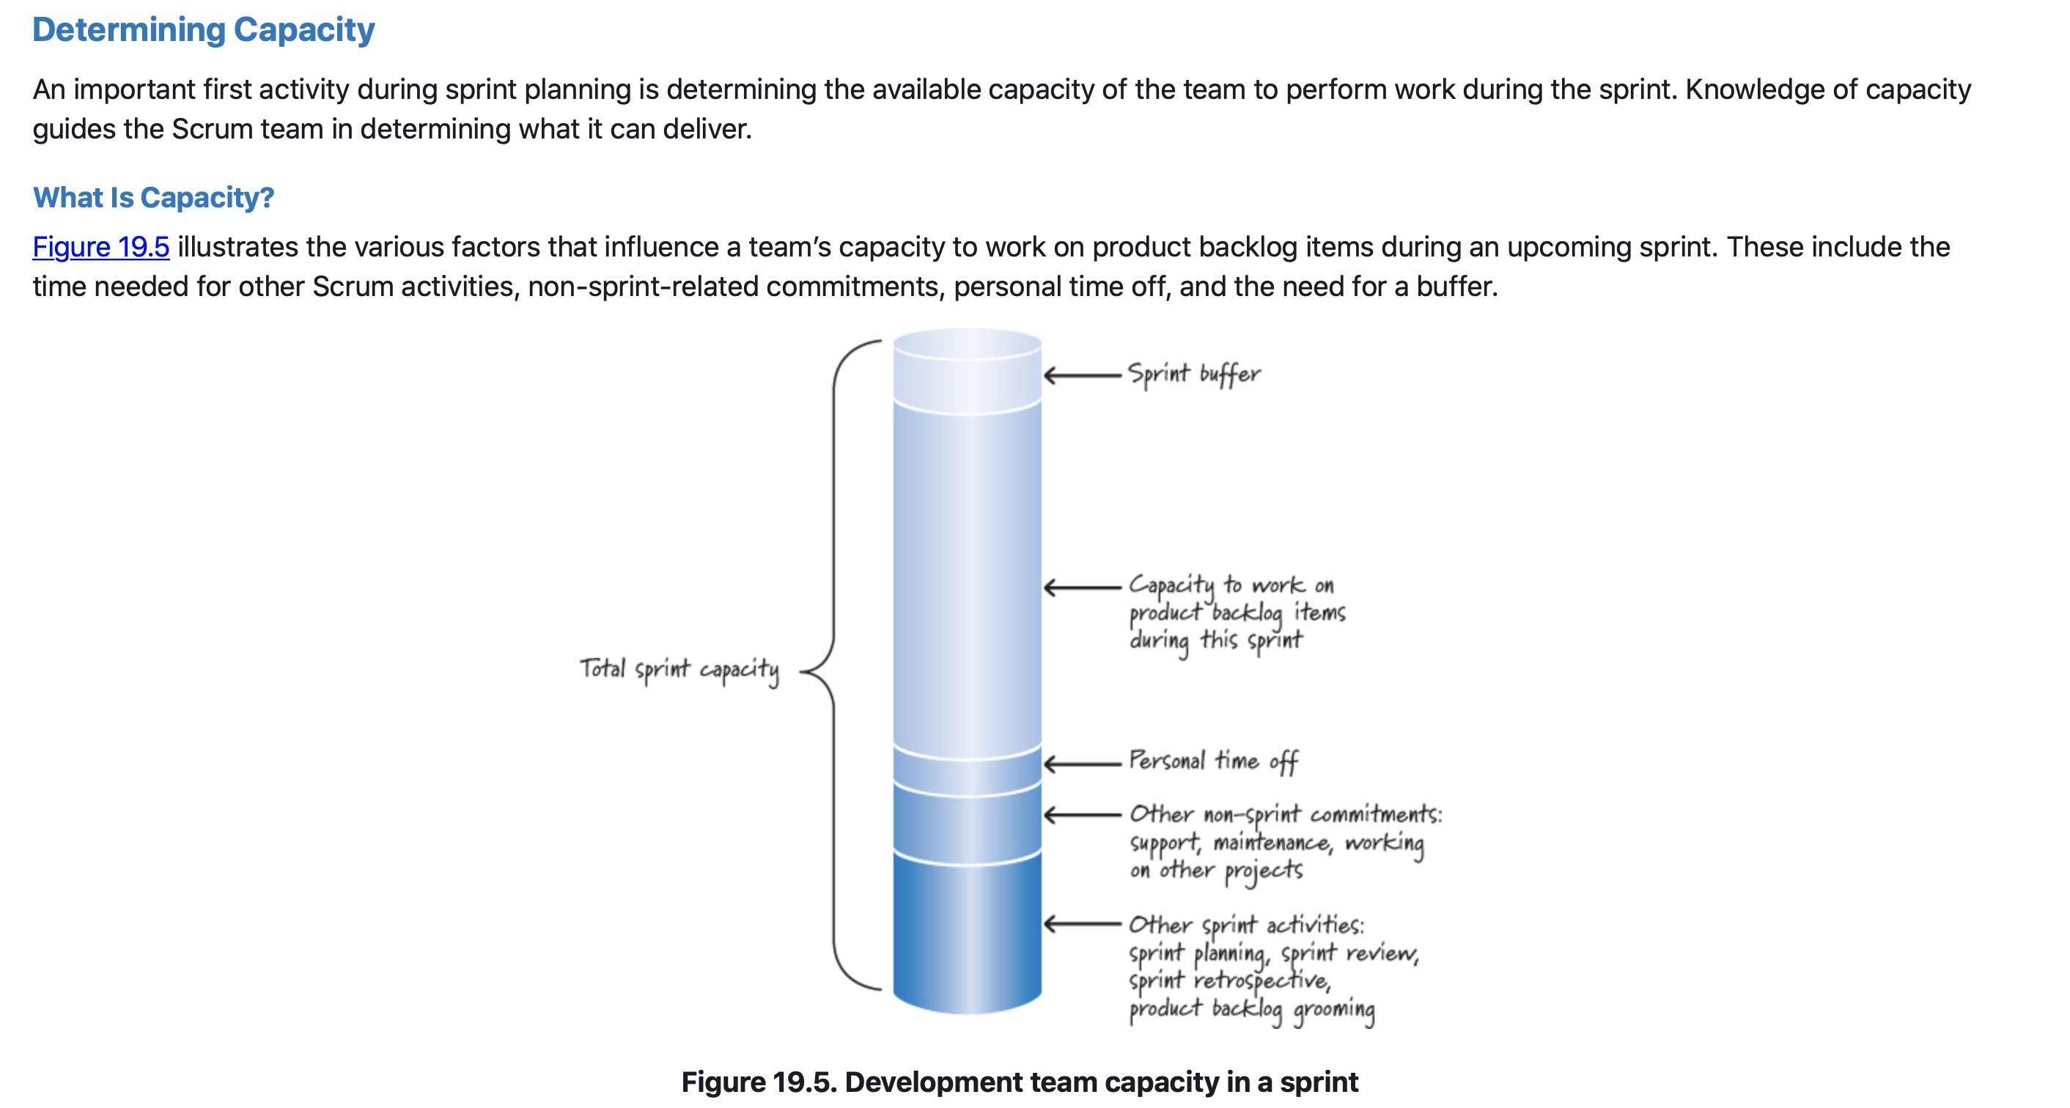
Sprint Planning – Determining Capacity

Slide 15
Sprint Planning – Determining Capacity
Capacity in Story Points
For example, let’s say our team’s average velocity is 40 story points during a two-week sprint.
The sprint we are planning, however, occurs during the last two weeks in December in the United States, which means many of our team members will be taking time off for the holidays.
We would take on too much work if we used the average velocity of 40; we’d be better off assuming that a velocity closer to 20 (or thereabouts) is a more realistic capacity for the team during this sprint.

Slide 16
Sprint Planning – Determining Capacity
Capacity in Story Points
A team’s velocity is expressed in terms of product backlog item units (let’s say story points).
So, if we express capacity in story points, determining capacity is the same as predicting our team’s target velocity for the upcoming sprint.
To make this determination, start with the team’s long-term average velocity or the team’s previous sprint velocity (sometimes referred to as the “yesterday’s weather” approach) as an initial estimate of its capacity/velocity for the upcoming sprint.
Then consider whether the upcoming sprint might differ from typical or previous sprints (it might not). The result is a reasonable adjusted capacity (predicted velocity) for the upcoming sprint.

Slide 17
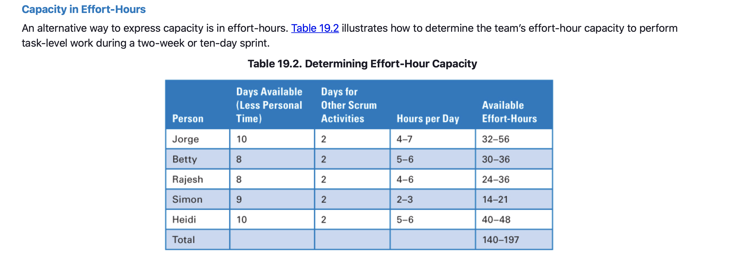
Sprint Planning – Determining Capacity
Notes:
After accounting for personal time off, other Scrum activities, and non-sprint commitments, the team in Table 19.2 estimates a capacity of 140 to 197 effort-hours to work on tasks in the sprint backlog.
I would caution this team against taking on 197 hours of work because it would leave no sprint buffer. A better strategy for this team would be to use a capacity that is probably greater than 140 hours but certainly less than 197 hours when committing to work during this sprint.

Slide 18
Sprint Planning – Selecting Product Backlog Items
Either approach to sprint planning requires that we select candidate product backlog items for inclusion in the commitment.
Selection can be done in several ways. If we have a sprint goal, we would select product backlog items that align with that goal.
If there is no formal sprint goal, our default is to select items from the top of the product backlog. We would start with the topmost item and then move to the next item and so forth.
If the team were not able to commit to the next-highest-priority item (perhaps there is a skills capacity issue), it would select the next appropriate higher-priority backlog item that looks as if it can be completed within the constraints.
Don’t start what can’t be finished.

Slide 19
Sprint Planning – Selecting Product Backlog Items
If the next product backlog item is too big to complete in the sprint given the other items that we have already agreed to complete, we should either try to break down the next item into two or more smaller items, each of which would be valuable to our customers, or consider working on another item that can be completed.
Having a good definition of ready will prevent product backlog items from being selected that are poorly defined or have unfulfilled resource or dependency constraints that would prevent our finishing them in a sprint.
The start-only-what-you-can-finish rule is based on the principles that we should limit WIP and that starting something and not finishing it generates a variety of forms of waste.

Slide 20
Sprint Planning – Acquiring Confidence
One way to acquire confidence in the ability to deliver is to use predicted velocity to see if the commitment is realistic.
If the predicted sprint velocity is 25 story points and our team has selected 45 story points’ worth of work, the team should be concerned. At the very least we should start asking questions about why we think the commitment can be achieved.
When used this way, velocity provides an excellent check and balance on the proposed commitment.
The risk of using velocity as the sole means of establishing confidence is that even though the numbers look right, the commitment might still be unachievable.

Slide 21
Sprint Planning – Acquiring Confidence
Until we dig a little deeper to the task level, we don’t really know if the set of product backlog items that total 21 story points can actually be completed—there could be dependency issues, skills capacity issues, as well as a host of other issues that make it impractical for the team to get them all done.
Most Scrum teams gain the necessary level of confidence by breaking the product backlog items down into the tasks that are required to complete them to the Scrum team’s agreed-upon definition of done.
These tasks can then be estimated (usually in effort-hours) and subtracted from the team’s capacity.
Breaking product backlog items into tasks is a form of design and just-in-time planning for how to get the items done.

Slide 22
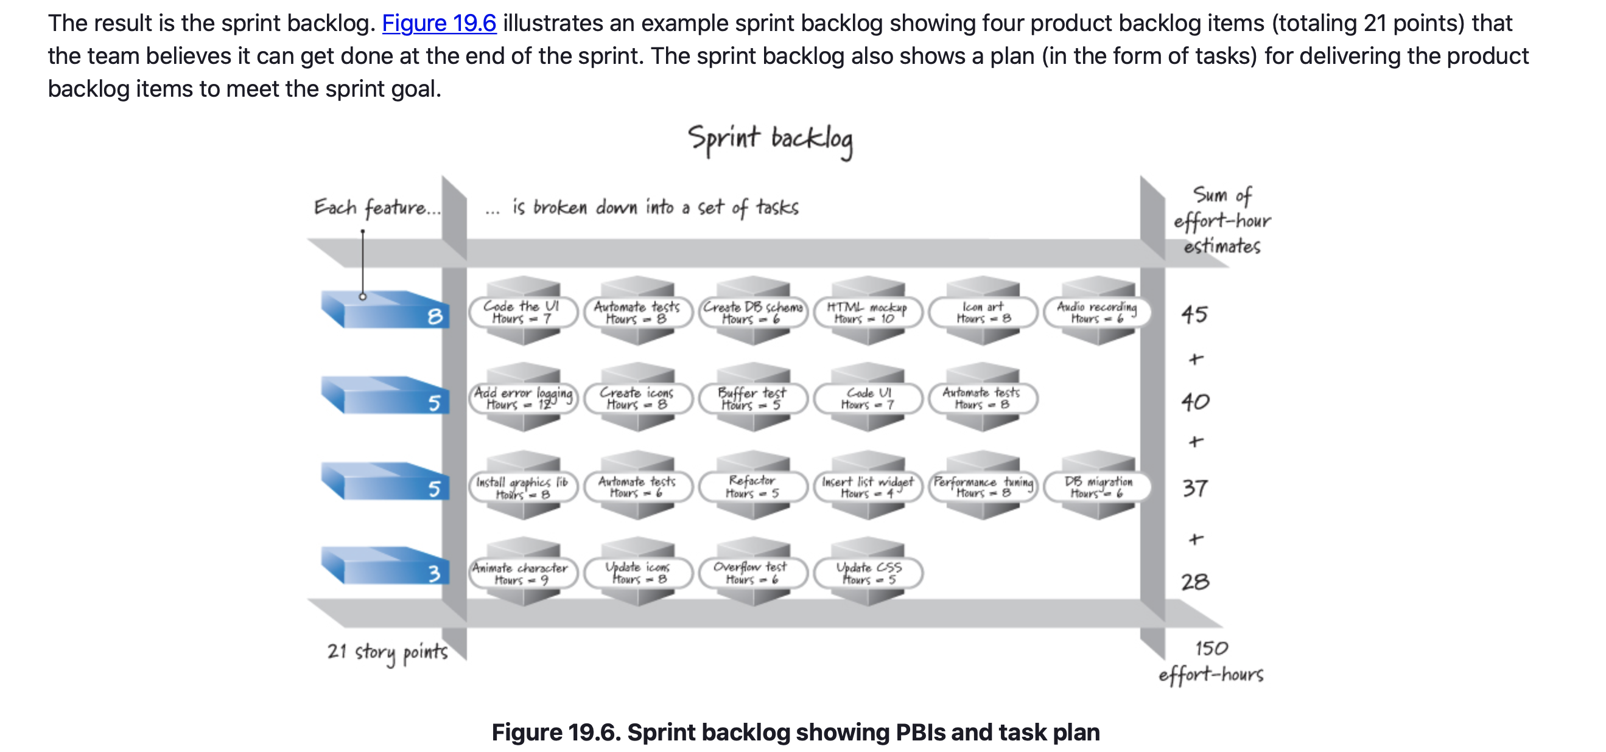
Sprint Planning – Acquiring Confidence

Slide 23
Sprint Planning – Refine the Sprint Goal
The sprint goal summarizes the business purpose and value of the sprint.
The product owner should come to sprint planning with an initial sprint goal.
That initial goal, however, can be refined during the course of sprint planning as the sprint-planning participants work together to determine what can realistically be delivered.

Slide 24
Sprint Planning – Finalize the Commitment
At the completion of sprint planning the development team finalizes its commitment to the business value it will deliver by the end of the sprint.
The sprint goal and the selected product backlog items embody that commitment.

Slide 25
Sprint Planning – Closing
Expanded in the description of sprint planning by discussing when sprint planning takes place and who is involved.
Discussed two different approaches to sprint planning.
In the first approach the team selects a set of product backlog items and then acquires confidence that it can indeed deliver the full set.
The second approach intermingles selecting a product backlog item with acquiring confidence that the item can be added to the incrementally growing commitment.
Explained two different ways to determine a development team’s capacity to complete work.

Slide 26
Sprint Planning
Sources
Unless otherwise noted, all material in these slides were used from the textbook for this course:
Rubin, Kenneth S., Essential Scrum: A Practical Guide to the Most
Popular Agile Process, 1st Edition. Addison-Wesley Professional; 1st
edition (August 5, 2012). ISBN-13: 978-0137043293.

